Slide 1
MINDBODYGREEN
AUDIENCE
DESCRIPTION ANALYSIS

Slide 2
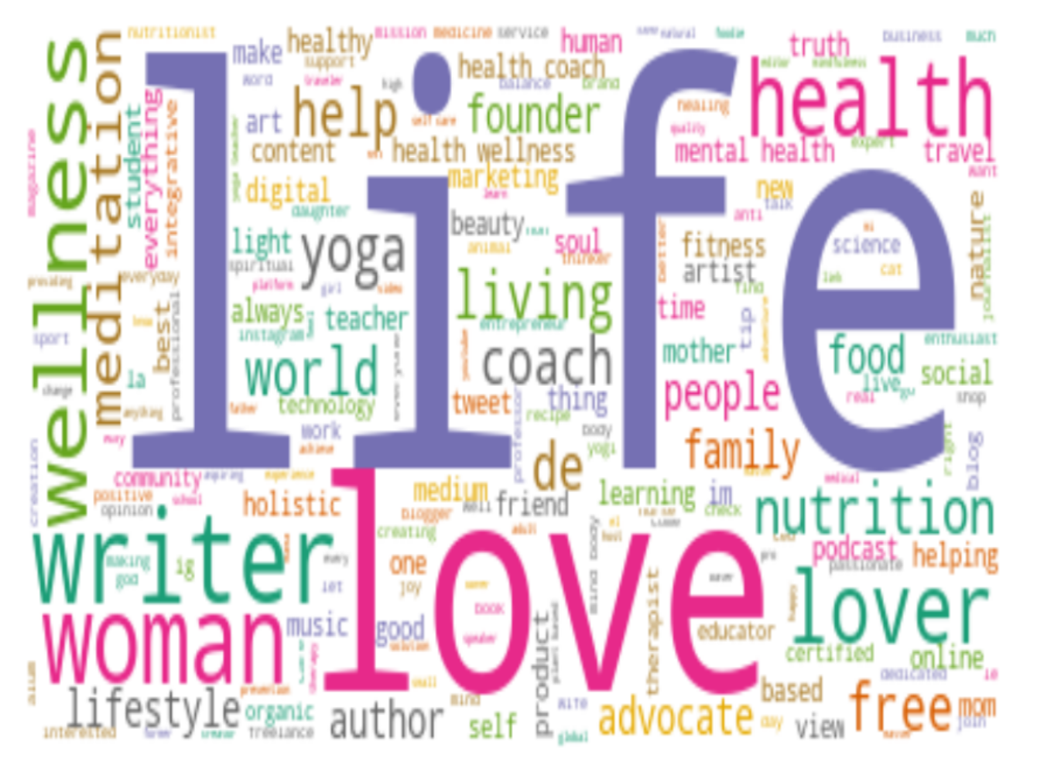
MBG AUDIENCE WORDCLOUD
The visual representation of text data on the left displays a list of words in different sizes, which represent the frequency or the importance of each word.
The corpus mentions a lot about “life” and “love”.

Slide 3
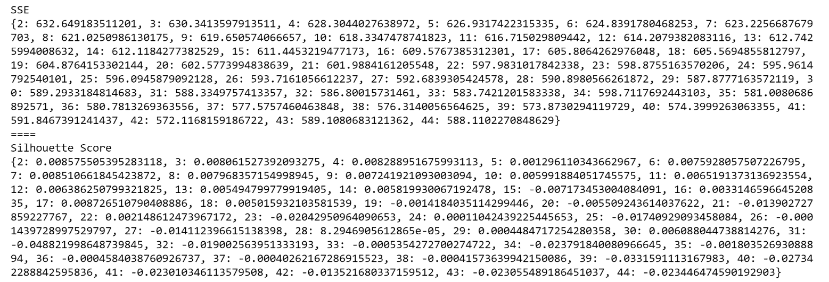
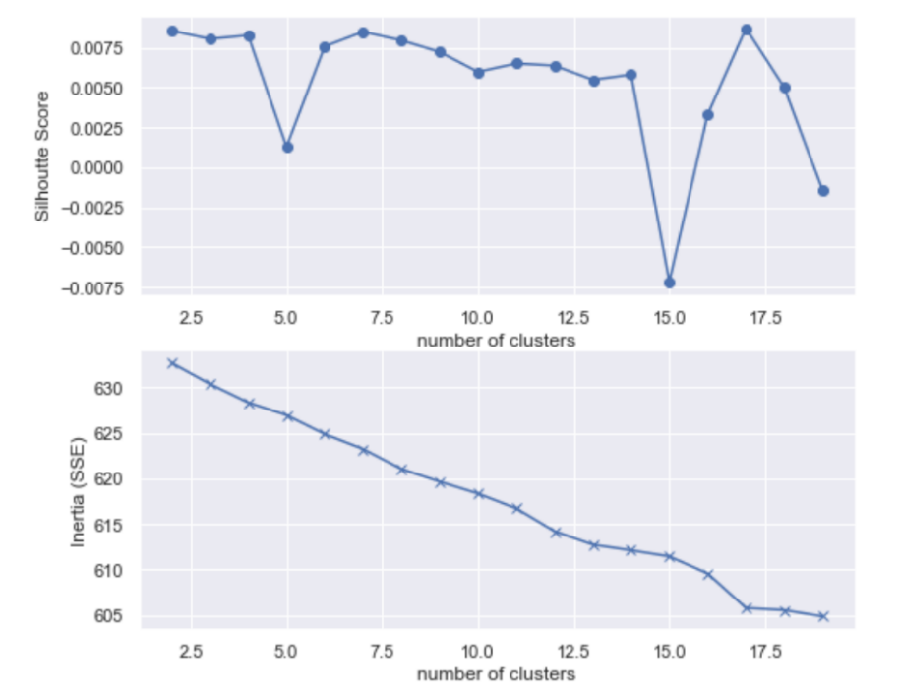
SSE & SILHOUETTE
Want high silhouette (ideally closer to 1) and low SSE scores.
7 seems like a decent number of clusters.
Notes:
K-means is a popular clustering algorithm. A company using this algorithm would be able to partition their customers into different groups depending on their characteristics. This can be a very useful way to engage in targeted advertising or to offer things like personalized discounts or promotions which is likely to drive revenue growth. For our use case, it can help give us quick insights and interpret text data.
To determine an ideal number of clusters, I employed the silhouette and SSE scores, which bring insight on how well defined the groups are. To select the best number of clusters I went through all the different clusters in each grouping by looking at graphs with the most dominant words in each group. I came to the conclusion that the groups made much more sense when they were divided into 7 different clusters.

Slide 4
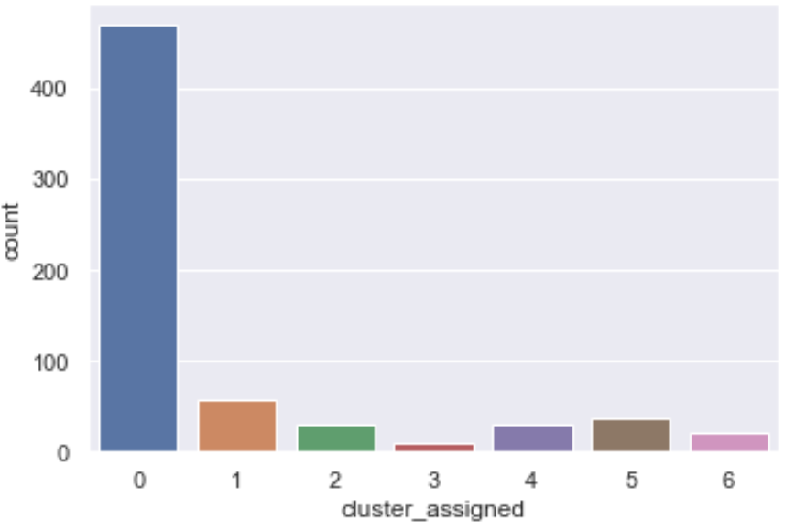
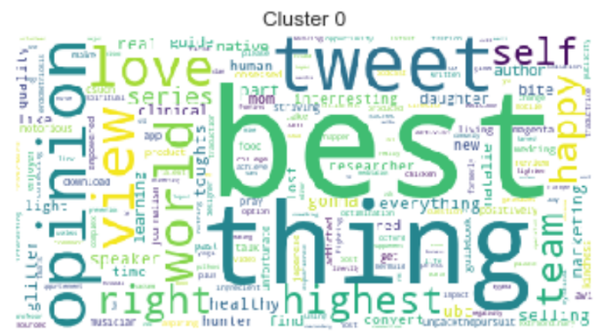
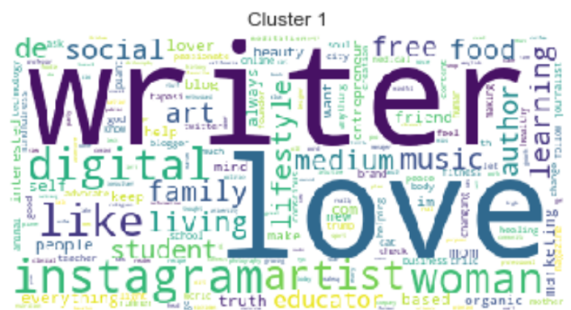
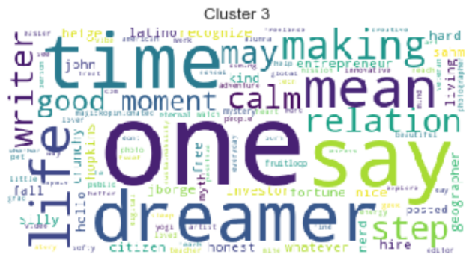
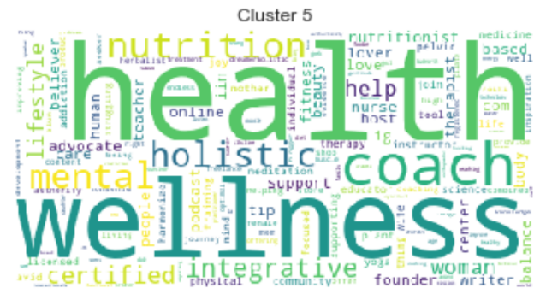
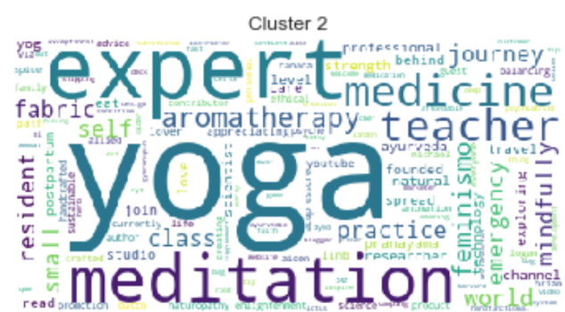
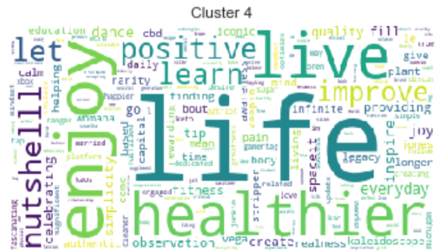
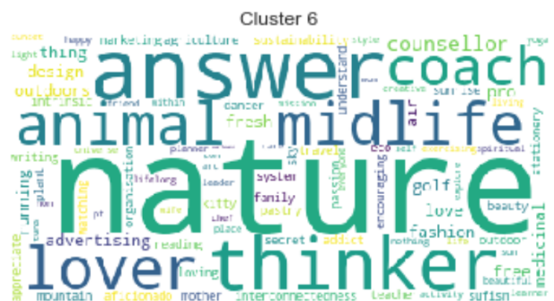
Top 15 Words/Cluster

Slide 5
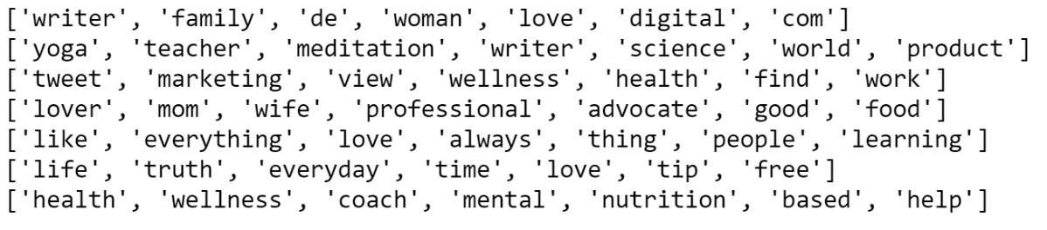
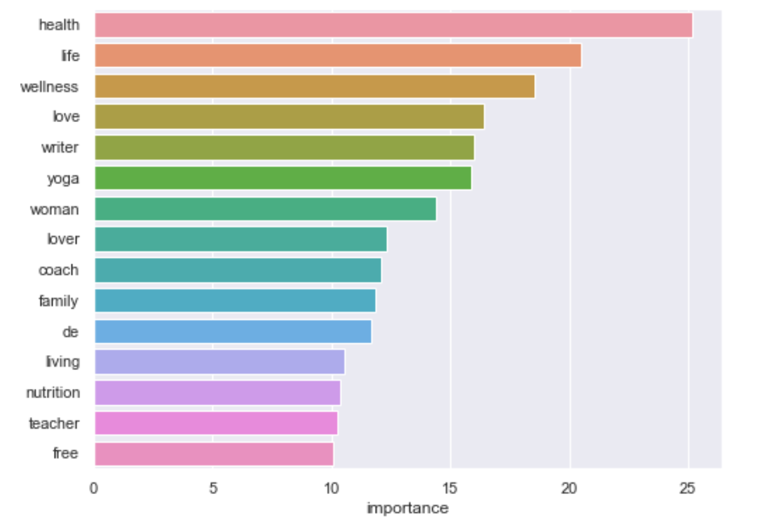
Uni-gram & Feature Importance
1: Family Oriented
2: Professional
3: Influencer
4: Nutrition/Vegan/Veg.
5: Learner
6: Truth Seeker
7: Wellness Coaching
Notes:
Above is the graph corresponding to the top 15 words in each cluster ordered by relative importance as measured by TF-IDF. Ok, so what are these figures trying to tell us? Are there any interesting features sticking out here? I would say in general, cluster 1 appears to have quite a few names of different professions associated with the followers which could be quite important. Immediately, we could start to look at tweets from a teacher and see if there is any interesting content.

Slide 6
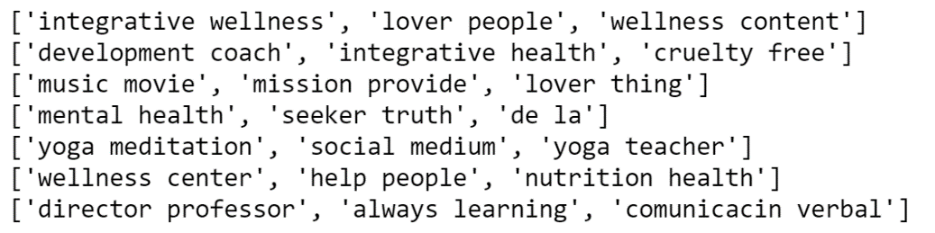
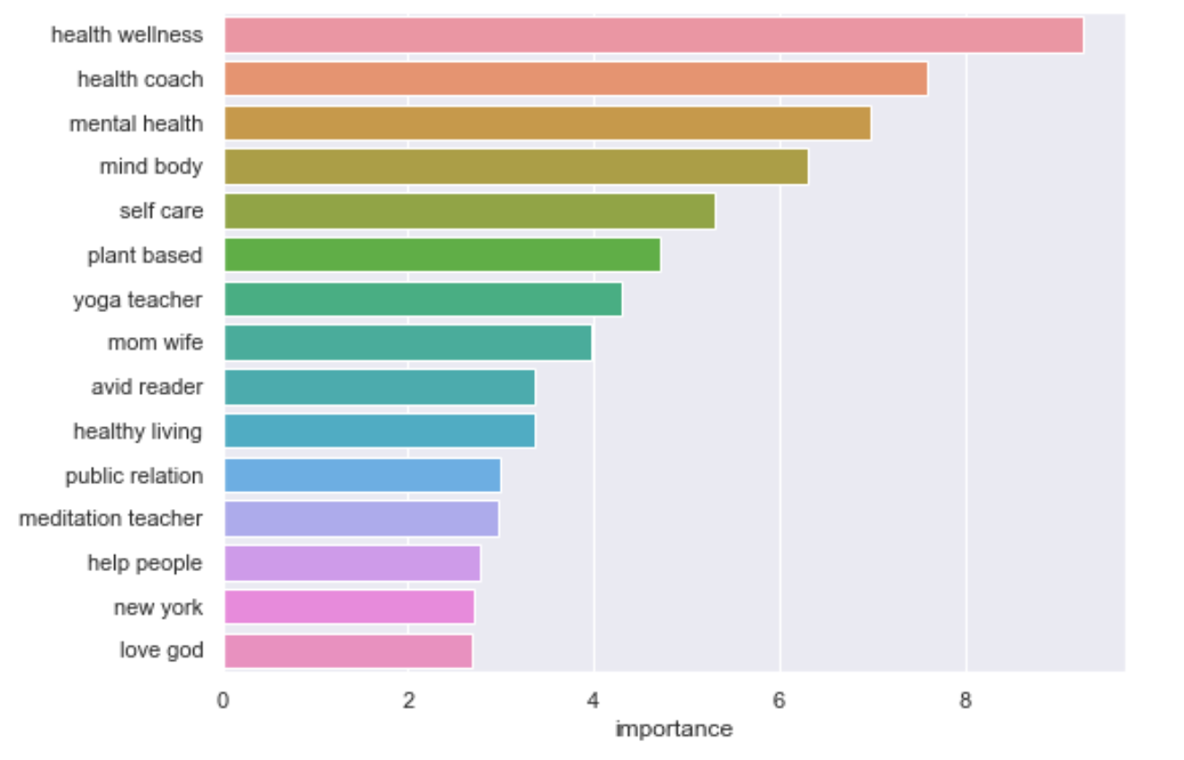
Bi-gram & Feature Importance
1: Holistic/Therapeutic
2: Animal Lovers
3: Vivacious/Passionate
4: Mental Health
5: Yoga/Influencer
6: Nutrition/Vegan/Veg.
7: Professional
Notes:
Cluster 4 seems to generally be about yoga. Again this could be quite useful in terms of narrowing down which tweets we want to examine further.

Slide 7
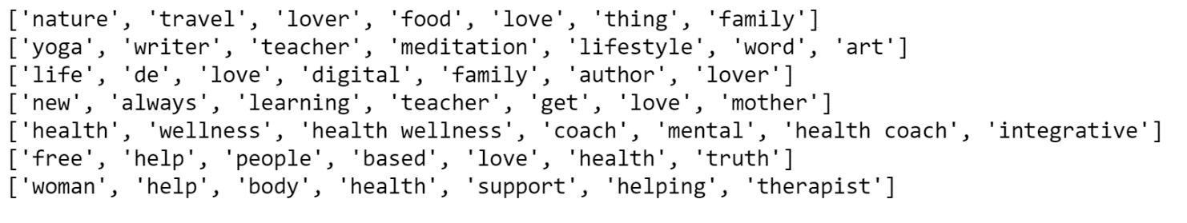
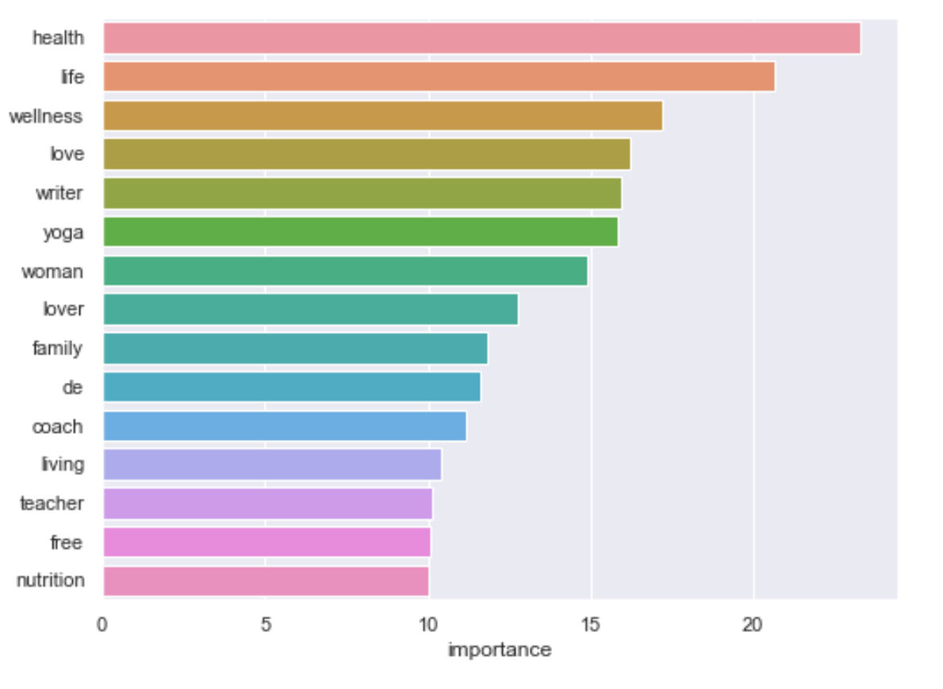
Uni- + Bi-gram & Feature Importance
1: Holistic Mindset
2: Mediation
3: Influencer
4: Learner
5: Mental Health
6: Truth Seeker
7: Wellness Coach
Notes:
Above is the graph corresponding to the top 15 words in each cluster ordered by relative importance as measured by TF-IDF. Ok, so what are these figures trying to tell us? Are there any interesting features sticking out here? I would say in general, cluster 0 seems to be generally about nature, food, travel… like the overall health being, so the best way I can describe them is holistic. Although ostensibly this doesn’t look immediately interesting it could also be worth further investigation.
This is especially useful when we have huge amounts of data and it isn't really practical for someone to manually go through it.

Slide 8
CONCLUSION
A micro-model that makes certain inferences about the audiences
Main topics: professions (writer, teacher, coach), interest (health, mental, truth), passions (life, nature, yoga, wellness)
MBG audiences are passionate about overall health, love nature, care about the truth, like to express opinions
Notes:
Above is the graph corresponding to the top 15 words in each cluster ordered by relative importance as measured by TF-IDF. Ok, so what are these figures trying to tell us? Are there any interesting features sticking out here? I would say in general, cluster 0 seems to be generally about nature, food, travel… like the overall health being, so the best way I can describe them is holistic. Although ostensibly this doesn’t look immediately interesting it could also be worth further investigation.
This is especially useful when we have huge amounts of data and it isn't really practical for someone to manually go through it.

